Slide 1
Basic Scholarship Awarding Graphs
Creating a way to allow scholarship awarding committee give scholarships in a fairer way

Slide 2
Introduction
Scholarship Matching is where a committee of people award scholarships to the most deserving applicants
However, due to the criteria used for awarding scholarships sometimes unexpected results can occur
Lower ranked students can get money than higher ranked students
Higher ranked students can get no awards
A single person can exceed the amount of money required
This paper examines 7 different algorithms for awarding scholarships to examine how they can be shown to be dysfunctional
This paper will result in the building of a GitHub repository where these algorithms will be built
This will include code to examine which algorithm is most logical with set of scholarships and applicants

Slide 3
The best way to understand this process
Scholarships and Applicants make up a bipartite graph
Scholarships with more money are more desirable for applicants
Applicants are ranked by most deserving of scholarships
Not all scholarship and applicant nodes will connect
Higher ranked applicants might not have more scholarships than lower ranked applicants
Scholarships applicants have specific requirements such as major which could bring more scholarships to lower applicants

Slide 4
Scholarships
Applicants
S1
A1
Lower Numbers
Show Higher Rankings
i.e.-
A1 is ranked higher than A2 who is ranked higher than A3
And
S1 is ranked higher than S2 who is ranked higher than S3
A2
S2
A3
S3
A4

Slide 5
Scholarships
Applicants
S1
A1
Not everyone is matched to every scholarship
A2
S2
S1-A1, S1-A2, S1-A4
S2-A1 S2-A3
S3-A1 S3-A2 S3-A3 S3-A4
A3
S3
A4

Slide 6
Scholarships
Applicants
S1
A1
1000
Scholarships have awarding amounts
A2
S2
This is part of what we use for rankings. A lower ranked scholarship will never have a higher amount than a higher ranked scholarship.
750
A3
S3
500
A4

Slide 7
There are seven common algorithms
Almost all of these use ranking or merit as a basis in their calculation
Split to all applicants is the only one to not use merit
Some modify the algorithm to get more award winners

Slide 8
Scholarships
Applicants
S1
A1
1000
2250
Algorithm 1:
Merit Only Awarding
A2
S2
In this algorithm, A1 would win every scholarship and would be awarded 2250 while A2-A4 would be awarding 0.
750
A3
S3
500
A4

Slide 9
Maximum
Award =1500
Scholarships
Applicants
S1
A1
1000
1750
Algorithm 2:
Merit Only Awarding Disqualify After Exceeding Maximum
A2
S2
500
In this graph, A1 would be disqualified after winning S2 because their total would exceed 1500. This allows A2 to win S3.
750
A3
S3
500
A4

Slide 10
Maximum
Award =1500
Scholarships
Applicants
S1
A1
1000
1500
Algorithm 3:
Merit Only Awarding Can’t Exceed Maximum
A2
S2
In this graph, A1 would can’t win S2 because it would bring them over the maximum award. However, they are not disqualified and then able to win S3.
Note than A2 wins nothing while A3 wins 750.
750
A3
750
S3
500
A4

Slide 11
The rational assumptions
RA1-The higher ranked applicant will be awarded more than the next highest ranked applicant
RA2-That a lower ranked applicant would not have more than the next highest ranked applicant. In other words, sequential ranked applicants can have the same amount, e.g. -1 has 1000 and 2 has 1000.
RA3-That if a lower ranked applicant would have a award that every higher ranked applicant would have an award
Since not everyone is qualified for every scholarship, these assumptions do not always hold true
However, if RA1 holds true, then RA2 and RA3 must be true
Not all algorithms for a given graph will hold both true
Committees will prefer the results that hold these true
Some committees will prefer giving more applicants than fewer

Slide 12
Only Allow 1 Award
Scholarships
Applicants
S1
A1
1000
1500
Algorithm 4
Maximum One Award Per Applicant
A2
In this graph, an applicant is removed from qualification after winning this award.
Note that the higher ranked A2 only is awarded 500 while A3 is awarded 750. This means the first rational assumptions doesn’t hold but the second assumption, all higher ranked applicants will have scholarship, does hold.
S2
500
750
A3
750
S3
500
A4
RA1- False
RA2- False
RA3-True

Slide 13
Scholarships
Applicants
333.33 Each
S1
A1
1000
833.33
Algorithm 5:
Split with all qualified applicants
A2
375 Each
458.33
S2
If we split the award amount among all the applicants, the amount given for each scholarship can be distorted.
750
A3
500
125 Each
S3
500
A4
458.33
RA1- False
RA2- False
RA3-True

Slide 14
Split with top 2 Applicants
Scholarships
Applicants
500 Each
S1
A1
1000
1125
Algorithm 6:
Split with minimum qualified applicants
A2
375 Each
750
S2
If we split the award amount among all the two applicants, the amount given for each applicant can still be distorted.
750
A3
375
250 Each
S3
500
A4
RA1- True
RA2- True
RA3-True

Slide 15
Split with all -250 Minimum
Scholarships
Applicants
333.33 Each
S1
A1
1000
1125.33
Algorithm 7:
Split with all qualified applicants with minimum amount given
A2
375 Each
538.33
S2
If we split the award amount among all the two applicants but limit the amount to 250, we actually end up with both rational assumptions being met in this particular case. Note some awards are greater than 250, it just cannot be split below 250. If the minimum was 500, S3 would only award 1 scholarship for 500.
750
A3
375
250 Each
S3
500
A4
333.33
RA1- True
RA2- True
RA3-True

Slide 16
Which method should we use?
Each of the previous seven algorithms has legitimate claim to be fair way to award the scholarships
However, methods which support RA1 or RA2 have a greater claim to logical fairness than methods that don’t with RA1 support the most fair
It could also be that the committee would favor an algorithm that gave to more applicants for various reasons
It is not obvious until after calculation which of these algorithms will yield these results
What I propose to create is a system which will calculate each algorithm and yield results to the user with their compliance with RA1 and RA2

Slide 17
Minimum Data Model to allow csv importing of data
Minimum Scholarship Applicant Model
Awarding Group Id
Integer to note unique group
Scholarship Id
Cant be a string to allow a real name
Scholarship Amount
Decimal
Applicant Id
Can be a string to allow full name
Applicant Ranking
Integer
Application ranking must not have skips
1,2,3 is allowable for a given scholarship but not 1,3,4
Application ranking must not have duplicates
Cannot have multiple with same rank

Slide 18
Other required parameters
Maximum Award Amount
For Merit with Maximum Award Amount Algorithm
Minimum Award Amount
For Split with Minimum Award Amount
Maximum Number of Winners
For Split with Maximum Amount of Winners

Slide 19
Required Outputs
List of awards for each algorithm
List of how algorithm did on RA1 and RA2

Slide 20
Languages to implement
SQL (MS-SQL Server)
Which would allow any language with ODBC compliance to access it
Will be full model
C#
R
Python
JavaScript

Slide 21
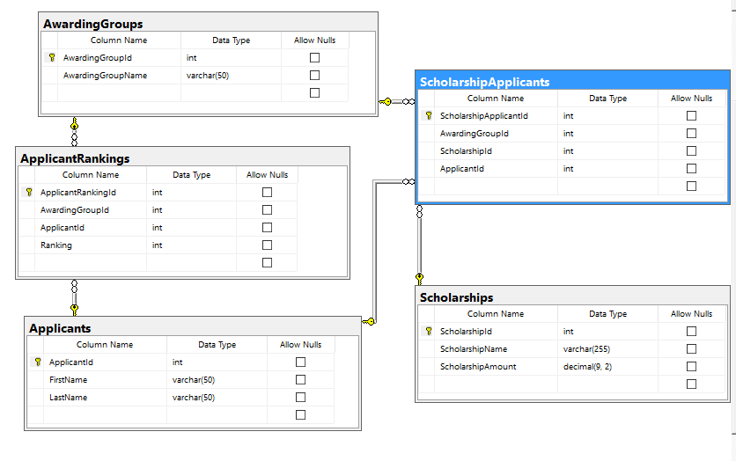
Full Normalized SQL Model

Slide 22
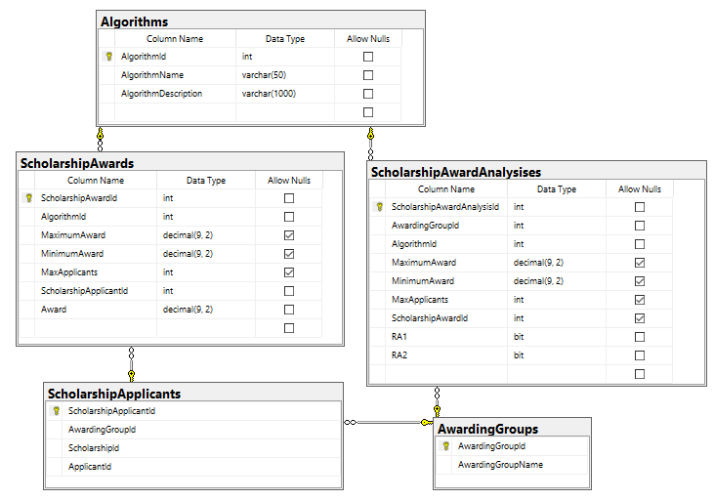
Normalized Results Tables

Slide 23
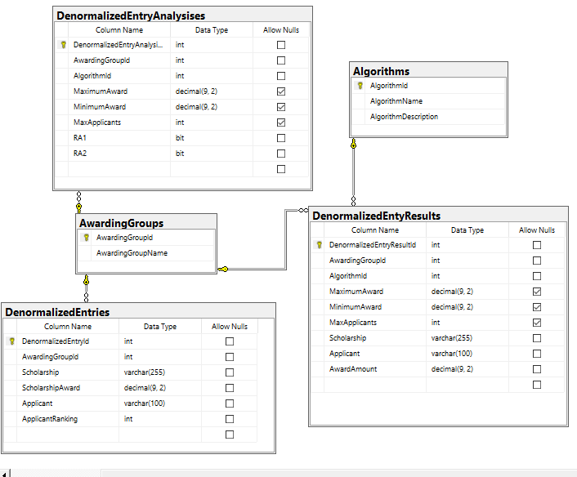
Denormalized For Easy csv Import

